Slide 1
Big Data - Lecture 11
Messaging Systems / Kafka

Slide 2
Notes
Project should be started - make sure and use Pivotal & Github
Please ask questions now and get going!
Most common mistake is to get going too late.
Projects are 60%+ of your grade

Slide 3
The need...
A large amount of data is generated by companies having any form of web-based presence and activity.
Data is one of the newer ingredients in these Internet-based systems and typically includes user-activity events corresponding to logins, page visits, clicks, social networking activities such as likes, sharing, and comments, and operational and system metrics.
This data is typically handled by logging and traditional log aggregation solutions due to high throughput (millions of messages per second).
These traditional solutions are the viable solutions for providing logging data to an offline analysis system such as Hadoop.
However, the solutions are very limiting for building real-time processing systems.

Slide 4
Message Brokers
In today's world, real-time information is continuously getting generated by applications (business, social, or any other type), and this information needs easy ways to be reliably and quickly routed to multiple types of receivers.
Most of the time, applications that are producing information and applications that are consuming this information are well apart and inaccessible to each other.
This, at times, leads to redevelopment of information producers or consumers to provide an integration point between them.
Therefore, a mechanism is required for seamless integration of information of producers and consumers to avoid any kind of rewriting of an application at either end.

Slide 5
Message Data
In the present big data era, the very first challenge is to collect the data and the second challenge is to analyze it.
This analysis typically includes following type of data and much more:
User behavior data
Application performance tracing
Activity data in the form of logs
Event messages

Slide 6
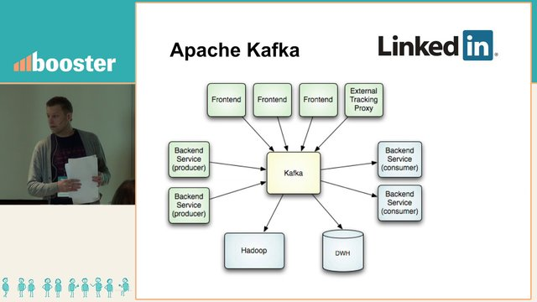
Created at LinkedIn

Slide 7
Enter Kafka...
Message publishing is a mechanism for connecting various applications with the help of messages that are routed between them, for example, by a message broker such as Kafka.
Kafka is a solution to the real-time problems of any software solution, that is, to deal with real-time volumes of information and route it to multiple consumers quickly.
Kafka provides seamless integration between information of producers and consumers without blocking the producers of the information, and without letting producers know who the final consumers are.
Apache Kafka aims to unify offline and online processing by providing a mechanism for parallel load in Hadoop systems as well as the ability to partition real-time consumption over a cluster of machines.
Kafka can be compared with Scribe or Flume as it is useful for processing activity stream data; but from the architecture perspective, it is closer to traditional messaging systems such as ActiveMQ or RabitMQ.

Slide 8
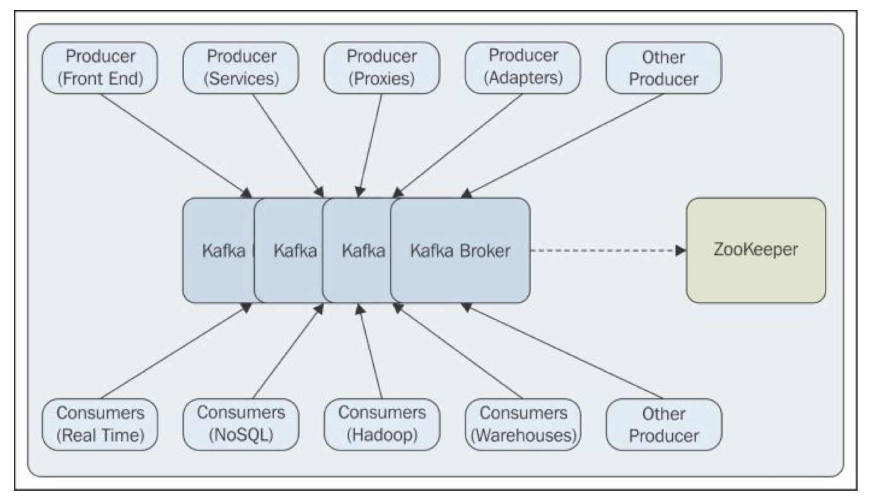
Typical Scenario

Slide 9
Kakfa Characteristics
Persistent messaging: To derive the real value from big data, any kind of information loss cannot be afforded. Apache Kafka is designed with O( 1) disk structures that provide constant-time performance even with very large volumes of stored messages, which is on order of TB.
High throughput: Keeping big data in mind, Kafka is designed to work on commodity hardware and to support millions of messages per second.
Distributed: Apache Kafka explicitly supports messages partitioning over Kafka servers and distributing consumption over a cluster of consumer machines while maintaining per-partition ordering semantics.
Multiple client support: Apache Kafka system supports easy integration of clients from different platforms such as Java, .NET, PHP, Ruby, and Python.
Real time: Messages produced by the producer threads should be immediately visible to consumer threads; this feature is critical to event-based systems such as Complex Event Processing (CEP) systems.

Slide 10
Terminology
Basic Kafka messaging terminology:
Kafka maintains feeds of messages in categories called topics.
We'll call processes that publish messages to a Kafka topic producers.
We'll call processes that subscribe to topics and process the feed of published messages consumers..
Kafka is run as a cluster comprised of one or more servers each of which is called a broker.

Slide 11
Producers and Consumers
Example Producers
Frontend web applications generating application logs
Producer proxies generating web analytics logs
Producer adapters generating transformation logs
Producer services generating invocation trace logs
Example Consumers
Offline consumers that are consuming messages and storing them in Hadoop or traditional data warehouse for offline analysis
Near real-time consumers that are consuming messages and storing them in any NoSQL datastore such as HBase or Cassandra for near real-time analytics
Real-time consumers that filter messages in the in-memory database and trigger alert events for related groups

Slide 12
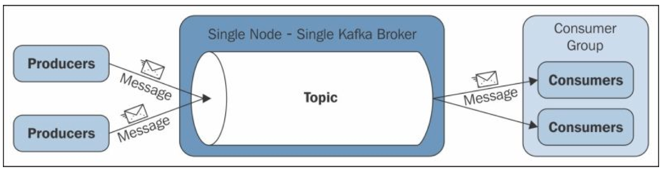
Basic Kafka Architecture
This architecture considers that all three parties—producers, Kafka broker, and consumers— are running on different machines.
Here, each consumer is represented as a process and these processes are organized within groups called consumer groups. A message is consumed by a single process (consumer) within the consumer group, and if the requirement is such that a single message is to be consumed by multiple consumers, all these consumers need to be kept in different consumer groups.
Garg, Nishant (2013-10-17). Apache Kafka (Kindle Locations 515-520). PACKT PUBLISHING. Kindle Edition.

Slide 13
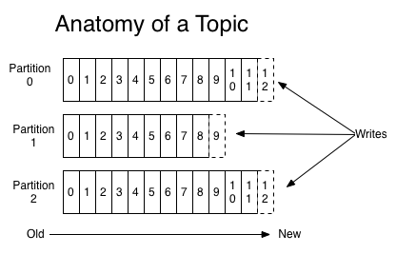
Topics
A topic is a category or feed name to which messages are published. For each topic, the Kafka cluster maintains a partitioned log that looks like this:

Slide 14
Partitions
Each partition is an ordered, immutable sequence of messages that is continually appended to—a commit log.
The messages in the partitions are each assigned a sequential id number called the offset that uniquely identifies each message within the partition.
The Kafka cluster retains all published messages—whether or not they have been consumed—for a configurable period of time.
For example if the log retention is set to two days, then for the two days after a message is published it is available for consumption, after which it will be discarded to free up space.
Kafka's performance is effectively constant with respect to data size so retaining lots of data is not a problem.
The partitions in the log serve several purposes.
First, they allow the log to scale beyond a size that will fit on a single server. Each individual partition must fit on the servers that host it, but a topic may have many partitions so it can handle an arbitrary amount of data.
Second they act as the unit of parallelism.

Slide 15
The “offset”
The only metadata retained on a per-consumer basis is the position of the consumer in in the log, called the "offset".
This offset is controlled by the consumer: normally a consumer will advance its offset linearly as it reads messages, but in fact the position is controlled by the consumer and it can consume messages in any order it likes.
For example a consumer can reset to an older offset to reprocess.
This combination of features means that Kafka consumers are very cheap—they can come and go without much impact on the cluster or on other consumers.
For example, you can use our command line tools to "tail" the contents of any topic without changing what is consumed by any existing consumers.

Slide 16
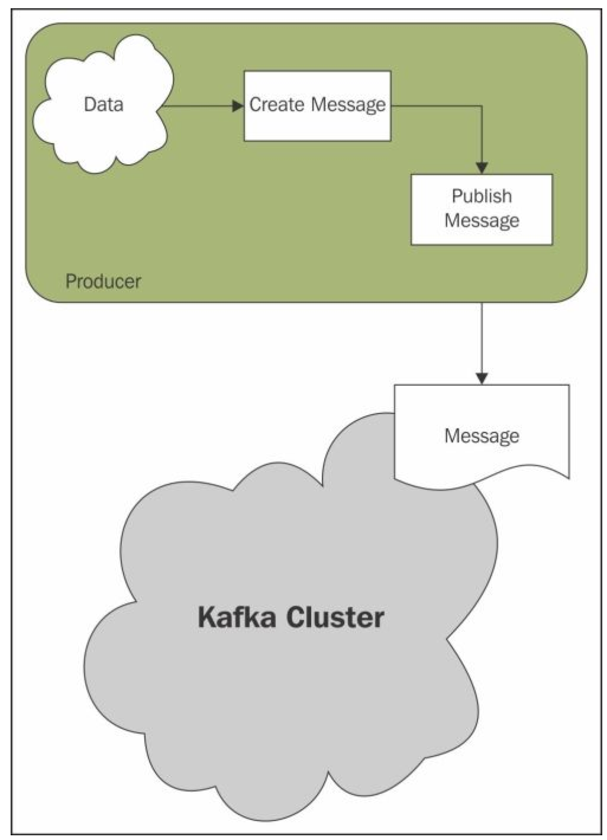
Producers
Producers publish data to the topics of their choice.
The producer is able to choose which message to assign to which partition within the topic.
This can be done in a round-robin fashion simply to balance load or it can be done according to some semantic partition function (say based on some key in the message).

Slide 17
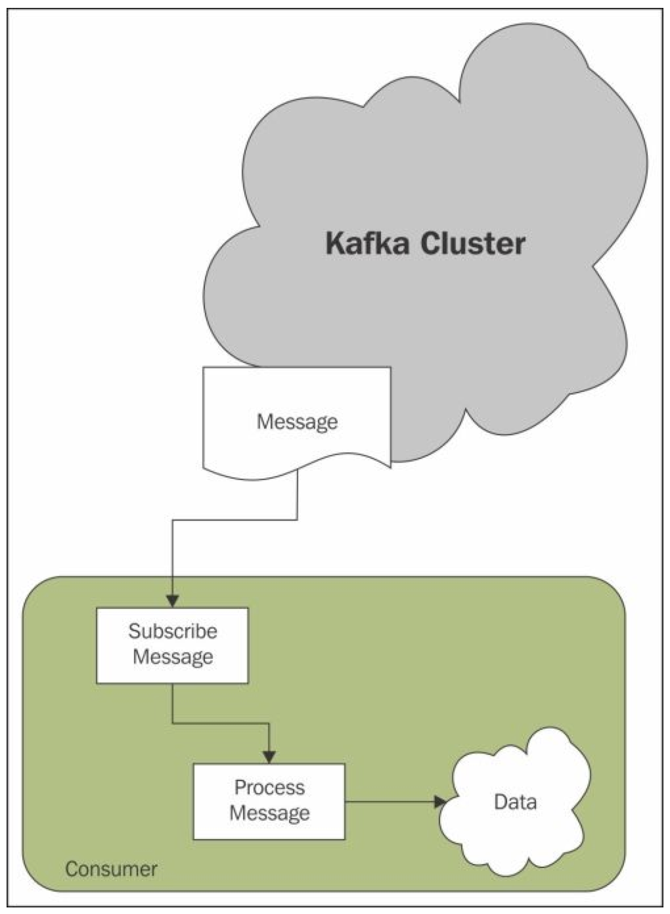
Consumers
Messaging traditionally has two models:
queuing
in a queue, a pool of consumers may read from a server and each message goes to one of them
publish-subscribe
in publish-subscribe the message is broadcast to all consumers.
Kafka offers a single consumer abstraction that generalizes both of these—the consumer group.
Consumers label themselves with a consumer group name, and each message published to a topic is delivered to one consumer instance within each subscribing consumer group.
Consumer instances can be in separate processes or on separate machines.
Notes:
If all the consumer instances have the same consumer group, then this works just like a traditional queue balancing load over the consumers.
If all the consumers instances have different consumer groups then this works like publish-subscribe and all messages are broadcast to all consumers.

Slide 18
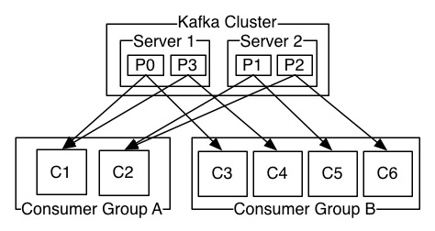
Parallel Consumption
Kafka has stronger ordering guarantees than a traditional messaging system.
A traditional queue retains messages in-order on the server, and if multiple consumers consume from the queue then the server hands out messages in the order they are stored.
However although the server hands out messages in order, the messages are delivered asynchronously to consumers, so they may arrive out of order on different consumers.
This effectively means the ordering of the messages is lost in the presence of parallel consumption.
Kafka does it better. By having a notion of parallelism—the partition—within the topics, Kafka is able to provide both ordering guarantees and load balancing over a pool of consumer processes.
Kafka only provides a total order over messages within a partition.
Notes:
This is achieved by assigning the partitions in the topic to the consumers in the consumer group so that each partition is consumed by exactly one consumer in the group. By doing this we ensure that the consumer is the only reader of that partition and consumes the data in order. Since there are many partitions this still balances the load over many consumer instances. Note however that there cannot be more consumer instances than partitions.

Slide 19
Guarantees
At a high-level Kafka gives the following guarantees:
Messages sent by a producer to a particular topic partition will be appended in the order they are sent. That is if a message M1 is sent by the same producer as a message M2, and M1 is sent first, then M1 will have a lower offset then M2 and appear earlier in the log.
A consumer instance sees messages in the order they are stored in the log.
For a topic with replication factor N, we will tolerate up to N-1 server failures without losing any messages committed to the log.

Slide 20
Short Video Description..
Big Data and Brews
https://www.youtube.com/watch?v=EiWsPd6JDoo

Slide 21
Use Cases
Messaging
Kafka works well as a replacement for a more traditional message broker. Message brokers are used for a variety of reasons (to decouple processing from data producers, to buffer unprocessed messages, etc). In comparison to most messaging systems Kafka has better throughput, built-in partitioning, replication, and fault-tolerance which makes it a good solution for large scale message processing applications.
Messaging uses are often comparatively low-throughput, but may require low end-to-end latency and often depend on the strong durability guarantees Kafka provides.
Website Activity Tracking
The original use case for Kafka was to be able to rebuild a user activity tracking pipeline as a set of real-time publish-subscribe feeds. This means site activity (page views, searches, or other actions users may take) is published to central topics with one topic per activity type. These feeds are available for subscription for a range of use cases including real-time processing, real-time monitoring, and loading into Hadoop or offline data warehousing systems for offline processing and reporting.
Activity tracking is often very high volume as many activity messages are generated for each user page view.
Metrics
Kafka is often used for operation monitoring data pipelines. This involves aggregating statistics from distributed applications to produce centralized feeds of operational data.

Slide 22
Use Cases (contd.)
Log Aggregation
Many people use Kafka as a replacement for a log aggregation solution. Log aggregation typically collects physical log files off servers and puts them in a central place (a file server or HDFS perhaps) for processing. Kafka abstracts away the details of files and gives a cleaner abstraction of log or event data as a stream of messages. This allows for lower-latency processing and easier support for multiple data sources and distributed data consumption. In comparison to log-centric systems like Scribe or Flume, Kafka offers equally good performance, stronger durability guarantees due to replication, and much lower end-to-end latency.
Stream Processing (Gnip’s Use Case)
Many users end up doing stage-wise processing of data where data is consumed from topics of raw data and then aggregated, enriched, or otherwise transformed into new Kafka topics for further consumption. For example a processing flow for article recommendation might crawl article content from RSS feeds and publish it to an "articles" topic; further processing might help normalize or deduplicate this content to a topic of cleaned article content; a final stage might attempt to match this content to users. This creates a graph of real-time data flow out of the individual topics. The Storm framework is one popular way for implementing some of these transformations.

Slide 23
Kafka Design Principles
The fundamental backbone of Kafka is message caching and storing it on the filesystem. In Kafka, data is immediately written to the OS kernel page. Caching and flushing of data to the disk is configurable.
Kafka provides longer retention of messages ever after consumption, allowing consumers to re-consume, if required.
Kafka uses a message set to group messages to allow lesser network overhead.
Unlike most of the messaging systems, where metadata of the consumed messages are kept at server level, in Kafka, the state of the consumed messages is maintained at consumer level.
This also addresses issues such as:
Losing messages due to failure
Multiple deliveries of the same message
By default, consumers store the state in ZooKeeper, but Kafka also allows storing it within other storage systems used for Online Transaction Processing (OLTP) applications as well.
In Kafka, producers and consumers work on the traditional push-and-pull model, where producers push the message to a Kafka broker and consumers pull the message from the broker.

Slide 24
Message Compression
Kafka provides a message group compression feature. Here, data is compressed by the message producer using either GZIP or Snappy compression protocols and decompressed by the message consumer.
There is lesser network overhead for the compressed message set where it also puts very little overhead of decompression at the consumer end.
This compressed set of messages can be presented as a single message to the consumer who later decompresses it. Hence, the compressed message may have infinite depth of messages within itself.
Message compression techniques are very useful for mirroring the data across datacenters using Kafka, where large amounts of data get transferred from active to passive datacenters in compressed format.

Slide 25
Distribution
The partitions of the log are distributed over the servers in the Kafka cluster with each server handling data and requests for a share of the partitions. Each partition is replicated across a configurable number of servers for fault tolerance.
Each partition has one server which acts as the "leader" and zero or more servers which act as "followers".
The leader handles all read and write requests for the partition while the followers passively replicate the leader.
If the leader fails, one of the followers will automatically become the new leader.
Each server acts as a leader for some of its partitions and a follower for others so load is well balanced within the cluster.

Slide 26
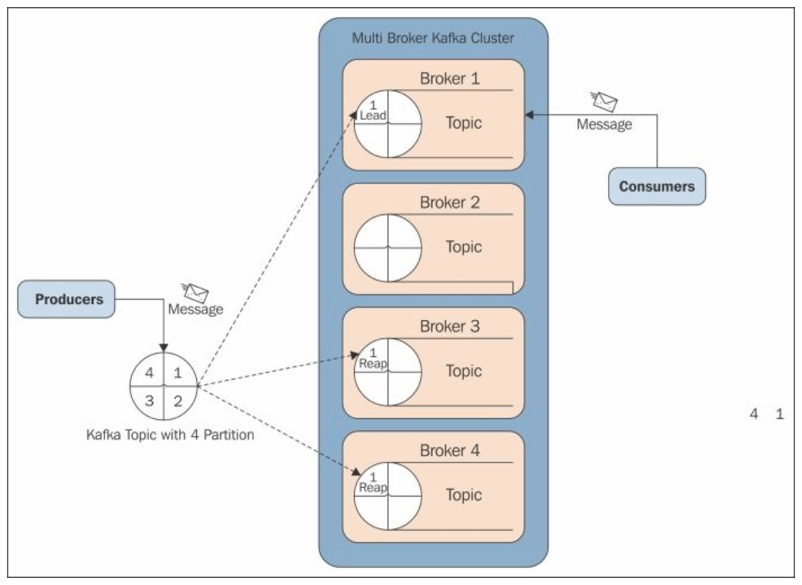
Multi Broker Cluster
Notes:
In replication, each partition of a message has n replicas and can afford n-1 failures to guarantee message delivery. Out of the n replicas, one replica acts as the lead replica for the rest of the replicas. ZooKeeper keeps the information about the lead replica and the current in-sync follower replica (lead replica maintains the list of all in-sync follower replicas).
Each replica stores its part of the message in local logs and offsets, and is periodically synced to the disk. This process also ensures that either a message is written to all the replicas or to none of them.

Slide 27
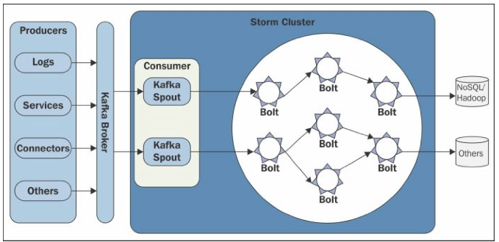
Integration with Storm
The source code for Kafka Storm Spout is available at
https://github.com/nathanmarz/ storm-contrib/ tree/ master/ storm-kafka

Slide 28
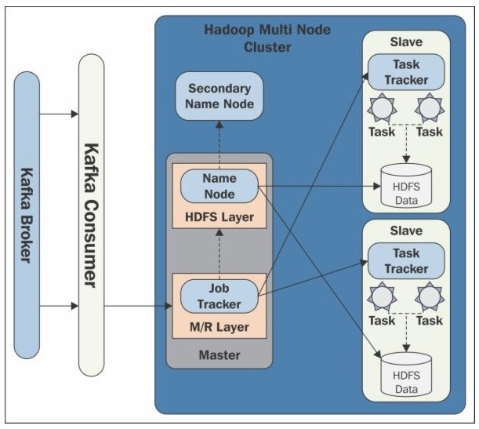
Integration with Hadoop (consumer)

Slide 29
Resources
Original LinkedIn paper: http://sites.computer.org/debull/A12june/pipeline.pdf
Kafka Apache Project: http://kafka.apache.org/documentation.html
Kafka Ecyosystem Tools: https://cwiki.apache.org/confluence/display/KAFKA/Ecosystem
Good blog post about log abstraction: http://engineering.linkedin.com/distributed-systems/log-what-every-software-engineer-should-know-about-real-time-datas-unifying

